Slide 1
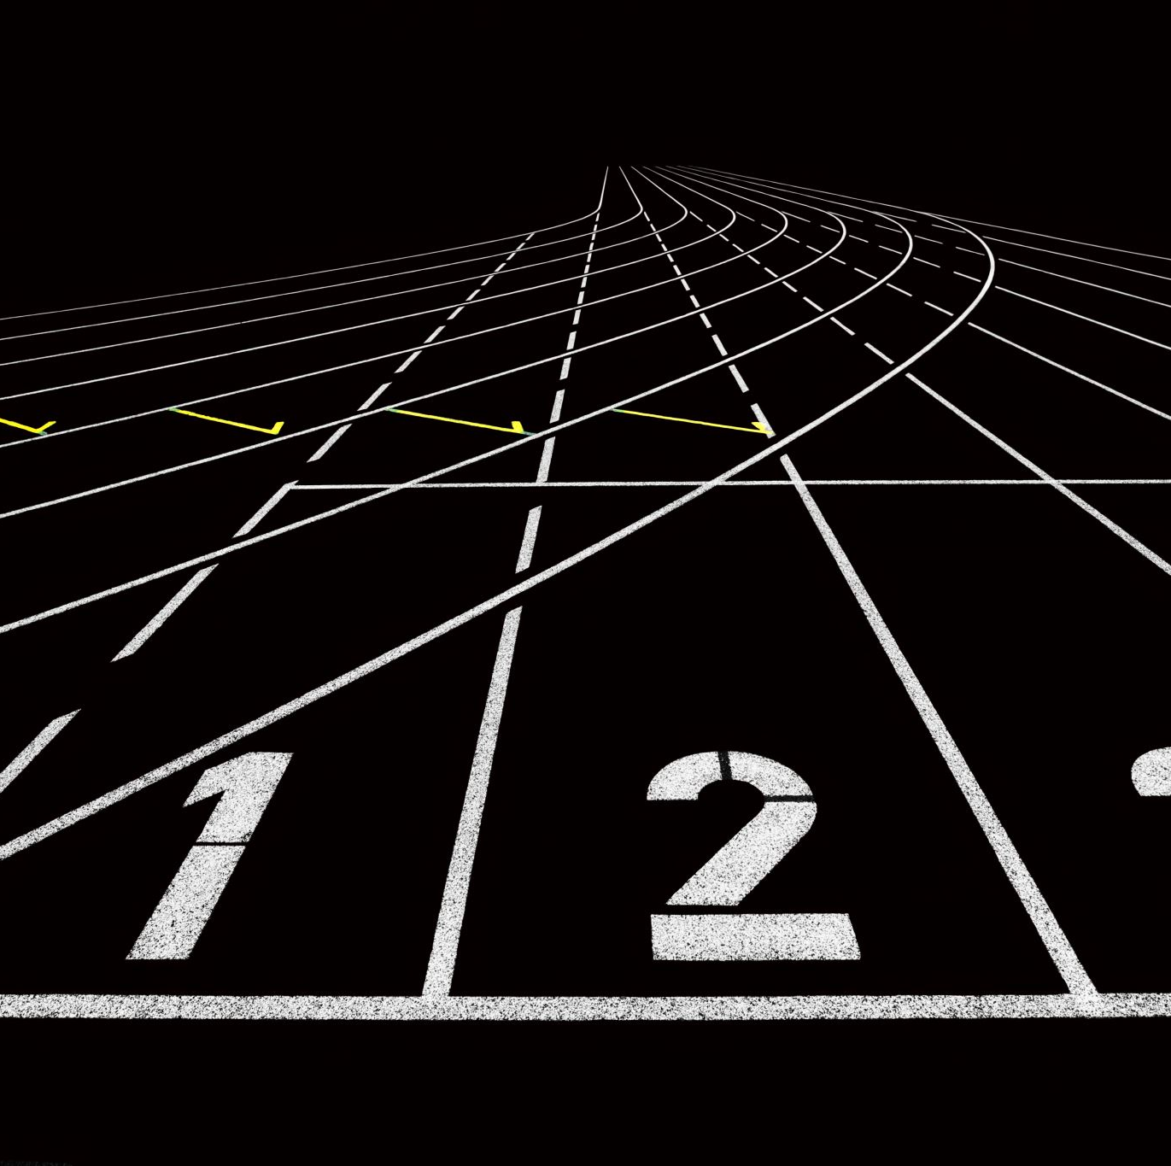
Plantastic sprint 1 review
Tevin, Lisa, Nadia, Marco and Dylan

Slide 2
Contents
Planning former sprints
What is completed?
Upcoming sprint

Slide 3
Planning former sprints
Project ideation
System design document
Introduction
Requirements
System context diagram(s)
Use cases
Use diagram
Redoing requirement based on use cases
Setting up the GIT repository
Creating a backlog
Research
Notes:
Project ideation: Nadia & Lisa
What is a CNC machine + design + project description
System Design document: Dylan & Tevin
System overview + system context diagram + problem analysis + project requirements + actors and scenarios + use cases (+ diagram)
Setting up the GIT: Nadia & Marco
Setting up the initial GIT and creating the initial assignments for everyone.
Creating Backlog: Marco
Creating protocol + Network connection diagram + UI wireframe + Code sensor(s) + Code spindle motor + Write code movement motor(s) + User interface code
Research: Everyone
Everyone chose and worked on their own research.

Slide 4
What is completed?
Project ideation
System design document (Sprint 1)
The GIT repository
Notes:
Project Ideation: Lisa
What is a CNC machine + design + project description
System design: Dylan
System overview + system context diagram + problem analysis + project requirements + actors and scenarios + use cases (+ diagram)

Slide 5
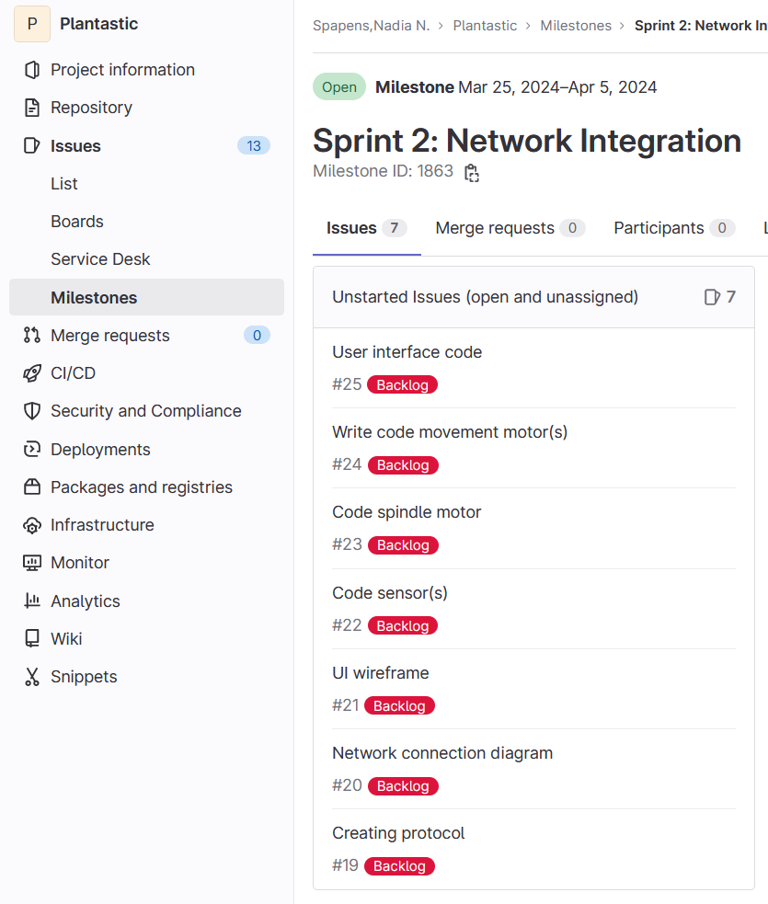
Upcoming sprint
Complete relevant research
Create network connection diagram
Protocol creation
Framework of UI
Component testing
Notes:
Upcoming sprint: Marco
Complete relevant research: Everyone finishes their respective research (documents).
Create network connection diagram:
Protocol creation: Making a protocol to have every component working with the other in an understandable fashion and making a protocol to translate G-Code into movements.
Framework of UI:
Component testing: Testing whether the components work as intended/ seeing how certain components work.

Slide 6

Questions?

